Slide 1
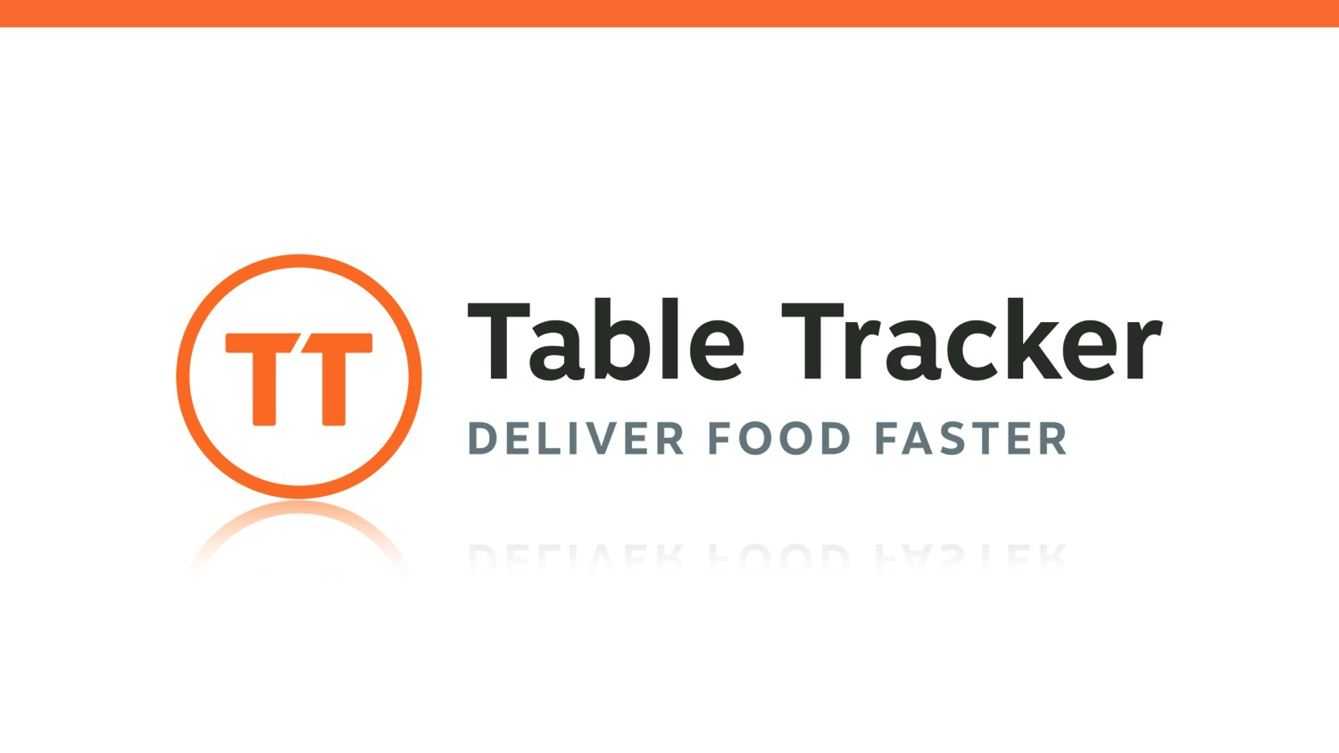

Slide 2
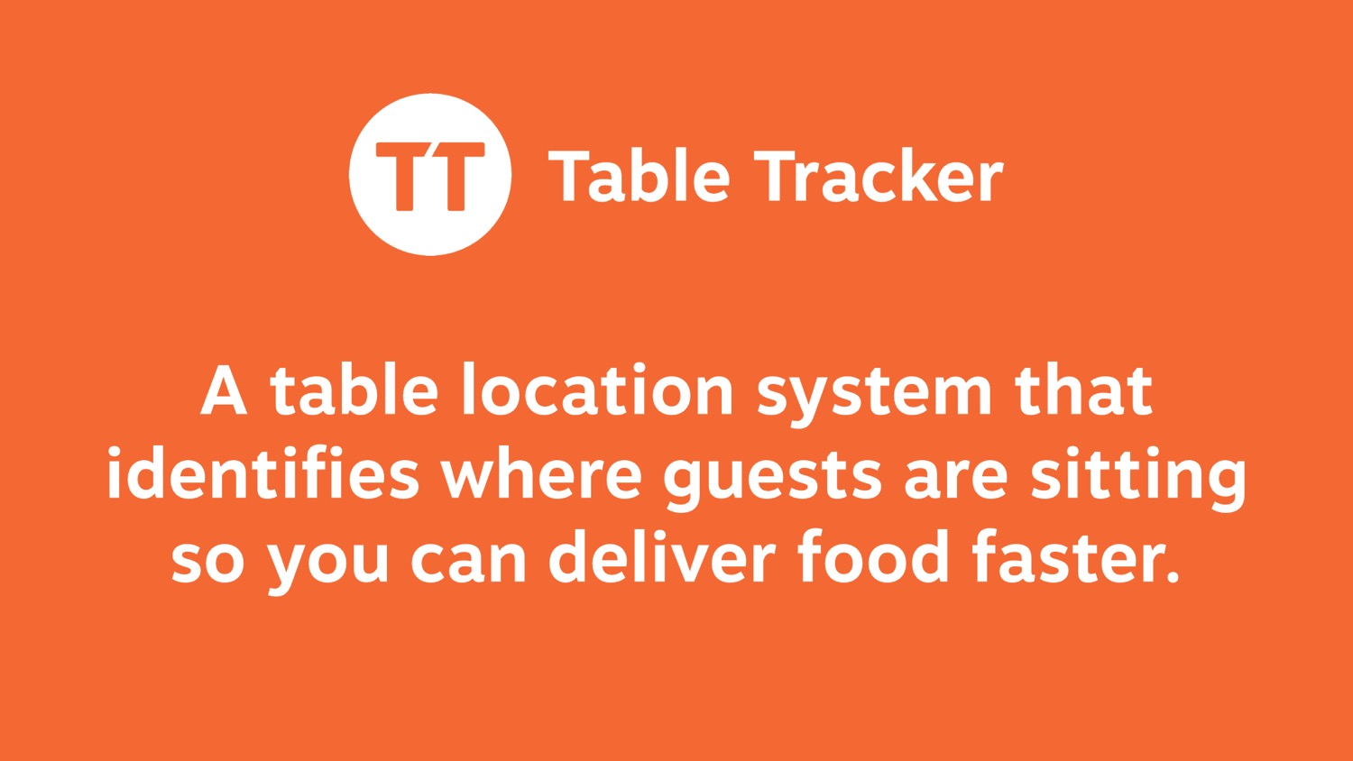
Notes:
TALKING POINTS –
Why Table Tracker? Enables you to provide a better guest experience.
What is Table Tracker? It’s a tool that helps fast casual restaurants find customers quickly, deliver food faster, and measure service performance.
How? It’s a table location system that identifies where guest are sitting.
QUESTIONS –
Are you currently delivering food to the table? If so, how?
What do you like about your current method?
How do you wish you could improve?
How would those improvements help your business?

Slide 3
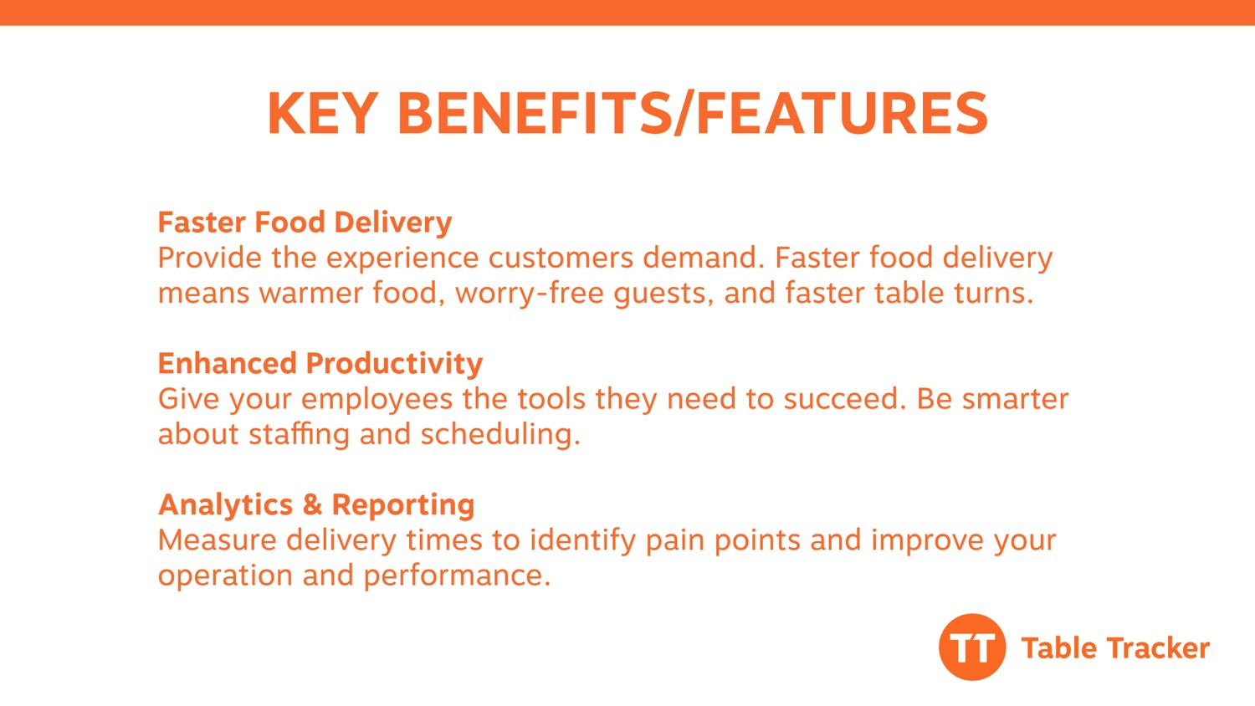
Notes:
TALKING POINTS –
Table Tracker replaces traditional number card systems, shouting of names over a PA system, or [INSERT CLIENT USE CASE IF RELEVANT], with automated location devices that identify where guests are sitting.
Benefits most often cited by our customers fall into one or more of these categories…
1) faster food delivery
2) enhanced productivity
3) ongoing reporting to measure delivery trends against specified goals
QUESTIONS –
Which of these benefits are important to you?
Is there another benefit you’re looking for from a table location system?

Slide 4
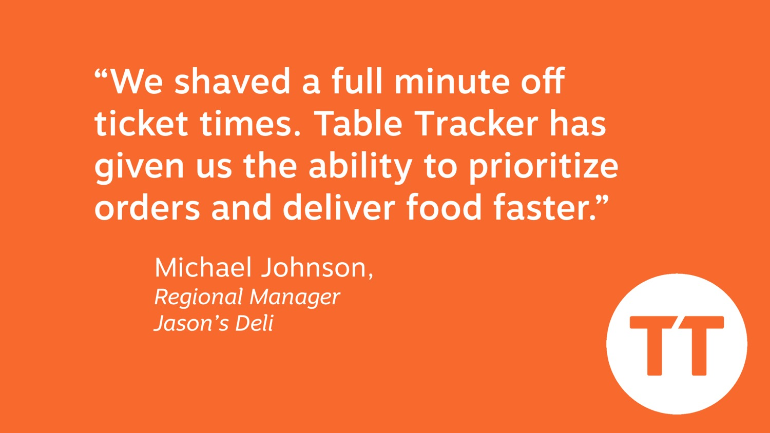
Notes:
TALKING POINTS –
Several clients have seen measurable results from Table Tracker.
Some see a significant decrease in delivery times, increase in table turns, and an increase customer satisfaction scores.
After installing Table Tracker and seeing the actual delivery times, clients are often surprised when they find out what their “real” delivery times. Most times, they think they’re getting food out faster than what’s really happening.
QUESTIONS –
What is your current order delivery goal?
How are you measuring to that goal today?
Do you track customer satisfaction?

Slide 5
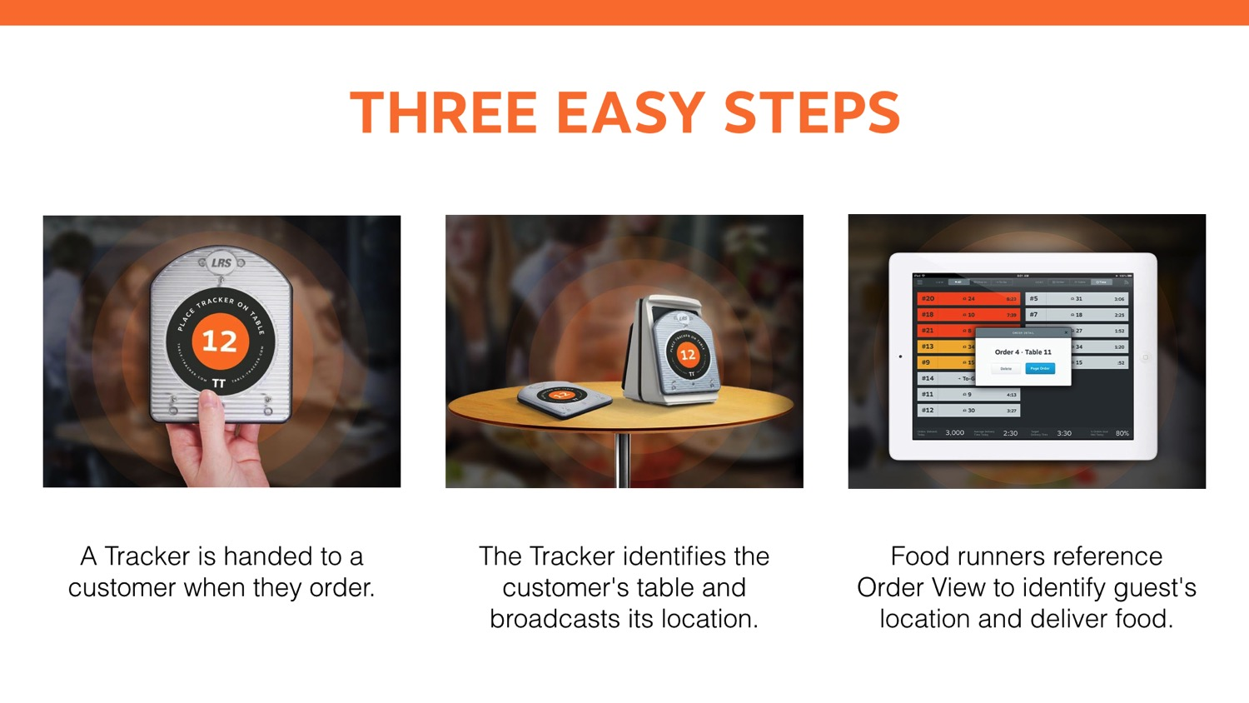
Notes:
TALKING POINTS –
Order – instead of a number card, a tracker is handed to a customer.
Locate – the tracker reads tags placed at each table to identify the location.
Deliver – when food is ready, the food runner references Table Tracker to know where to deliver the order.
QUESTIONS –
Before I go through the details, do you have any questions about how Table Tracker generally works?

Slide 6
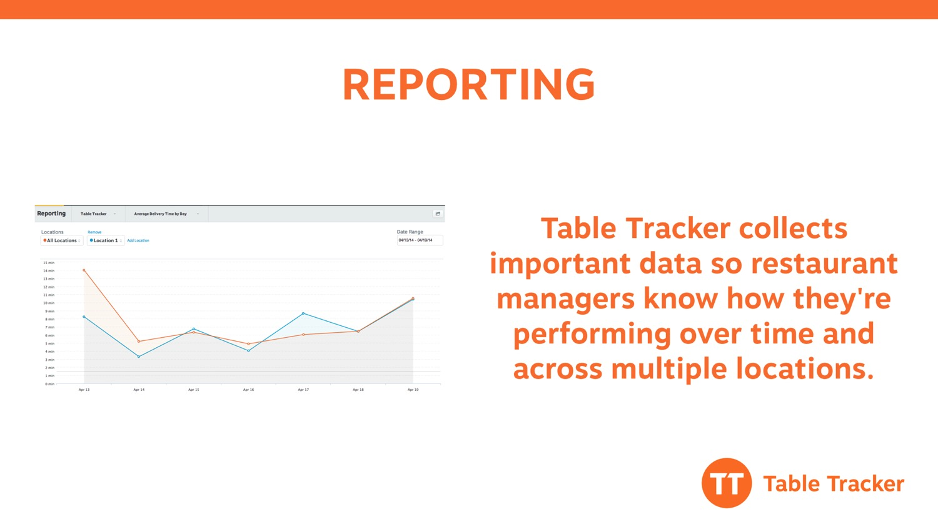
Notes:
TALKING POINTS –
Each order is stored in our system so that managers can understand performance over time.
Reporting is provided both within the Table Tracker application and online via a web dashboard.
The in-app reports provide on-site management two weeks of data to monitor their store’s performance.
The online dashboard provides advanced reporting with up to two years of data and the ability to look at store-to-store comparisons.
Popular reports include (there are more):
Daily average delivery time by day, week, and even time of day
Average % goal met over time
To-go vs. dine-in orders
Table usage
All online reporting is exportable.
QUESTIONS –

Slide 7
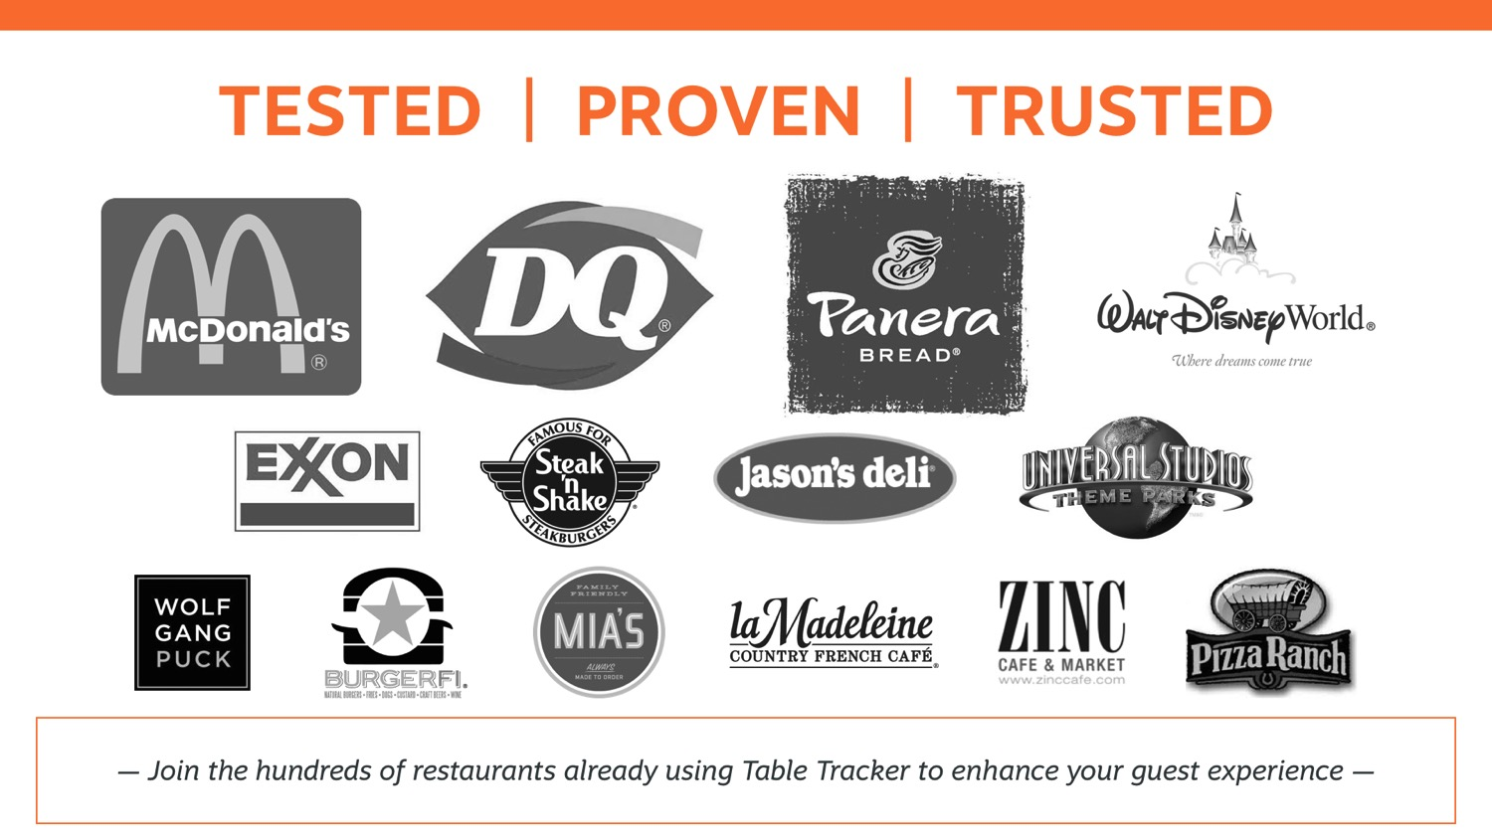
Notes:
TALKING POINTS –
The list of Table Tracker clients continues to grow
Lately, we’ve seen a lot of interest from quick-serve restaurants seeking to improve the dine-in experience by incorporating table service.
And, we’ve seen some fast casuals incorporating self-serve kiosks for customers to order food; and then, they’re reallocating labor to table delivery and service.
QUESTIONS –
Have you seen or used Table Tracker?
What did you think?
What did you like about it?

Slide 8
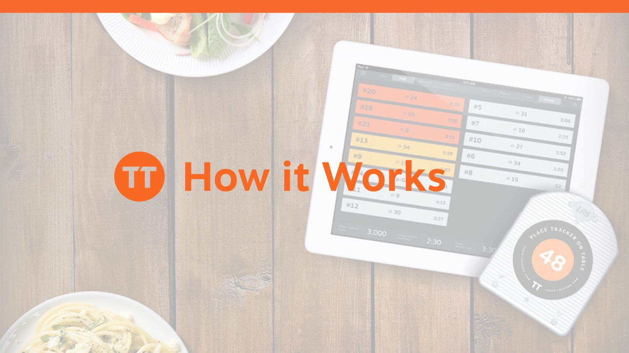

Slide 9
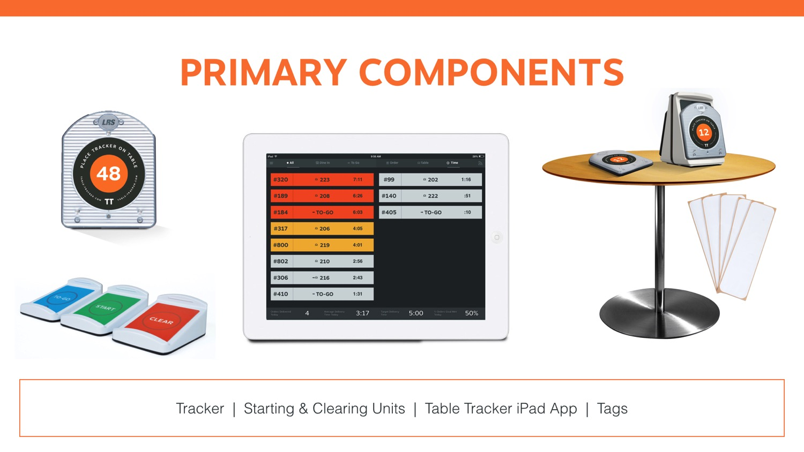
Notes:
TALKING POINTS –
The primary components include:
iPad* with the Table Tracker app – the Table Tracker app operates as the central user interface for food runners to reference where each order is located.
Each strip represents an order.
The order number is on the left, the table location in the middle, and the time elapsed between the order placement to delivery is on the right.
Strips will change color to yellow to indicate when an order is getting close to your delivery goal, and again to red when the order has surpassed the delivery goal.
Trackers – Trackers, when place on a table, identify the customer’s location which appears within the Table Tracker application.
Starters and Clearers – Trackers are “started” using a starter unit. That’s what starts the clock when an order is placed. Clearers are used to stop the clock upon delivery.
Tags – Tags are placed on each table to locate precisely where the customer is sitting. There are options for table tagging which we’ll cover a little later.
*An iPad is required for the system. Customers can purchase iPads through LRS or they can source their own. iPads must be at third generation or higher. All iPads sold through LRS are distributed by an approved Apple re-seller and covered by Apple’s 90-day phone support and 1-year warranty.
QUESTIONS –
There are more components than these, however these are the primary elements. Do you have any questions so far?

Slide 10
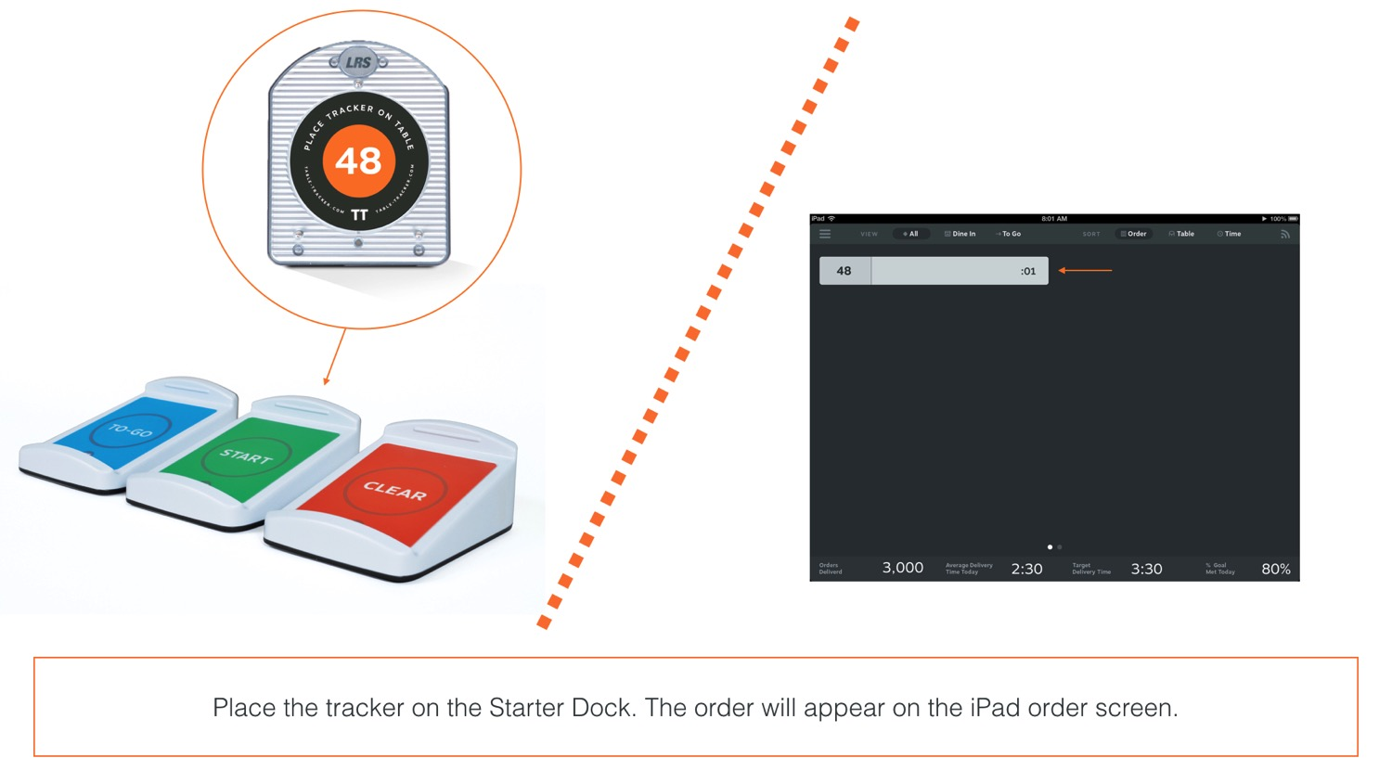
Notes:
TALKING POINTS –
Trackers are set beside your cashiers.
When an order is placed, the number on the tracker is entered in the POS.
The cashier will start the tracker using the green starter unit.
The order will then appear on the Table Tracker application.
QUESTIONS –
What POS system do you use?
Do you use a kitchen display system? If so, which one?
Table Tracker is like an extension of those tools, simply providing you way to track where a customer is located.
Do you have any questions?

Slide 11
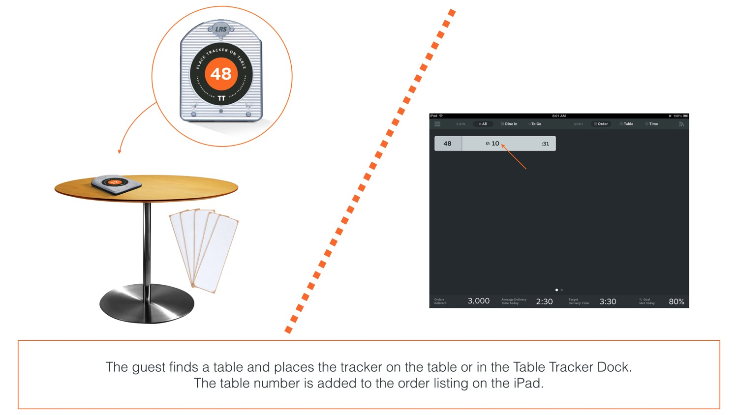
Notes:
TALKING POINTS –
Once the guest finds a table, the tracker reads the location via the tags on your table.
The table number then appears within the order strip on the Table Tracker application.
QUESTIONS –
Do you number your tables?
Do you change your table configuration often?

Slide 12
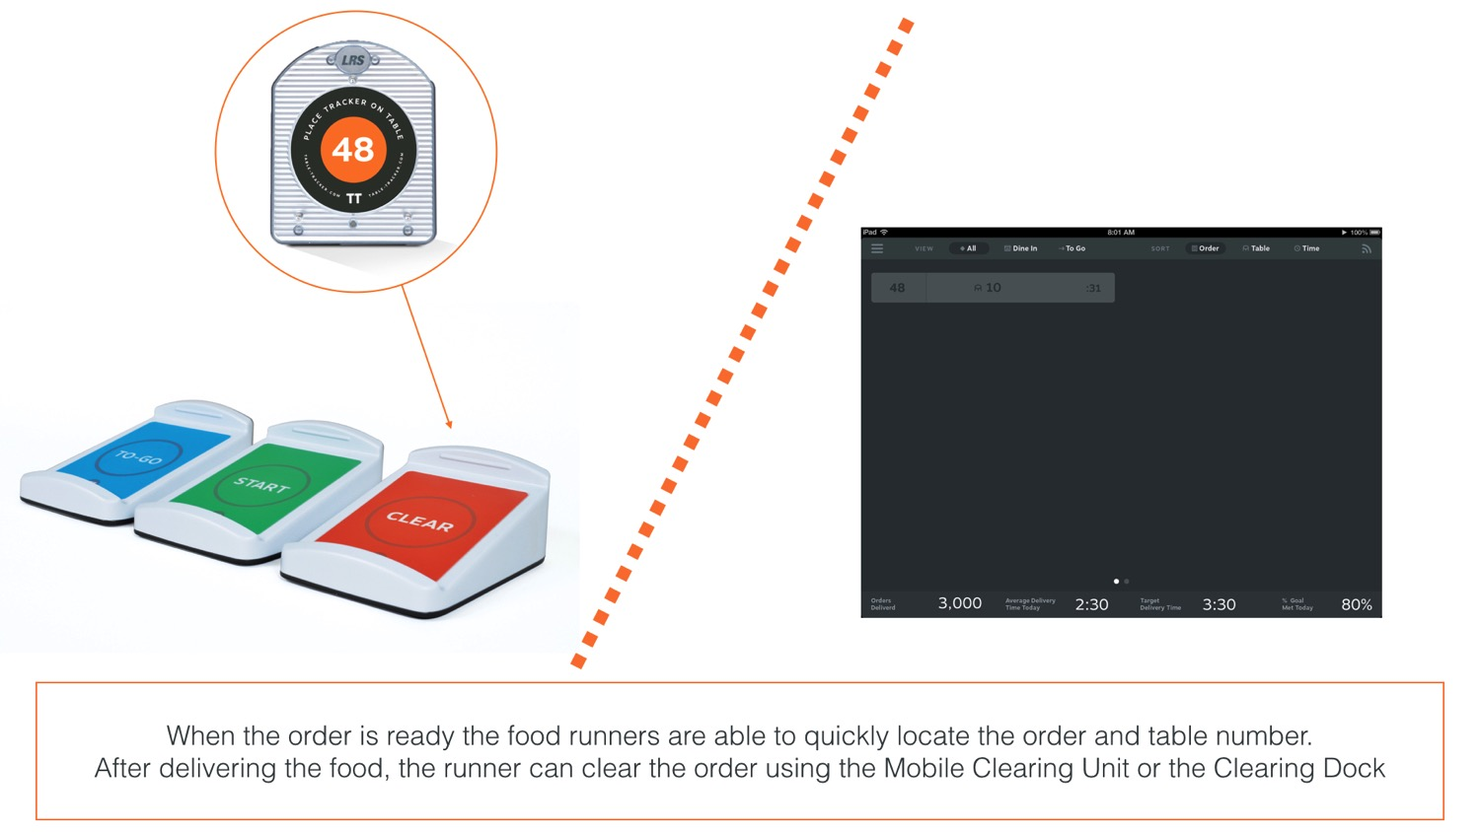
Notes:
TALKING POINTS –
When the food is ready, the food runner takes the order to the customer.
At that point, the food runner “clears” the order using the red clearing unit.
This stops the clock on the order and clears it from the Order View screen on the Table Tracker application.
QUESTIONS –
How many food runners do you have?
Do they ever struggle to find a customer?

Slide 13
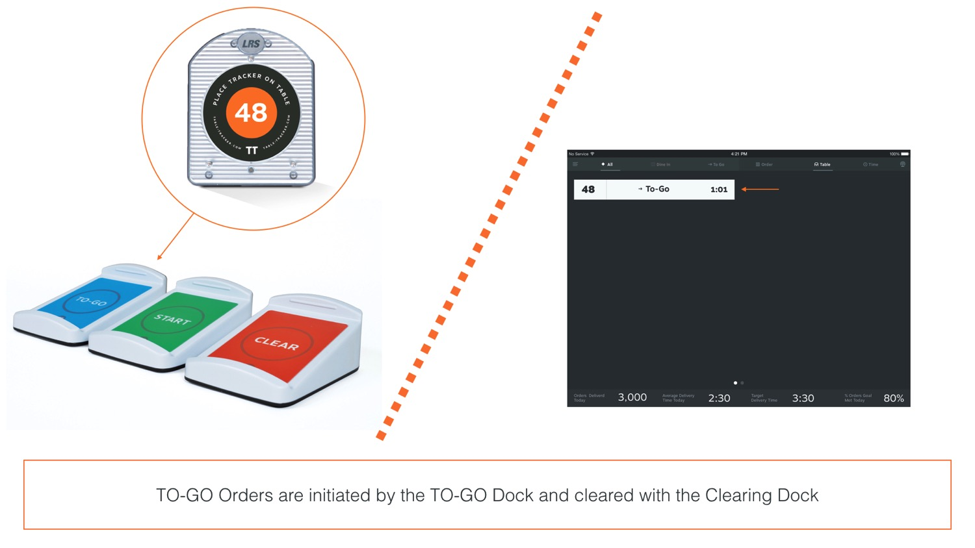
Notes:
TALKING POINTS –
In addition the green starter unit for dine-in orders, we offer a blue to-go starter unit.
To-go orders are differentiated by the “To-Go” words appearing in place of the table number.
Additionally, a small arrow is noted by “To-Go” incase a customer decides to sit at a table. That way, the table number appears so you can take it to the customer; and the arrow remains to the left letting you know that the order is to-go.
QUESTIONS –
Do you offer to-go?
How do you track to-go orders today?

Slide 14
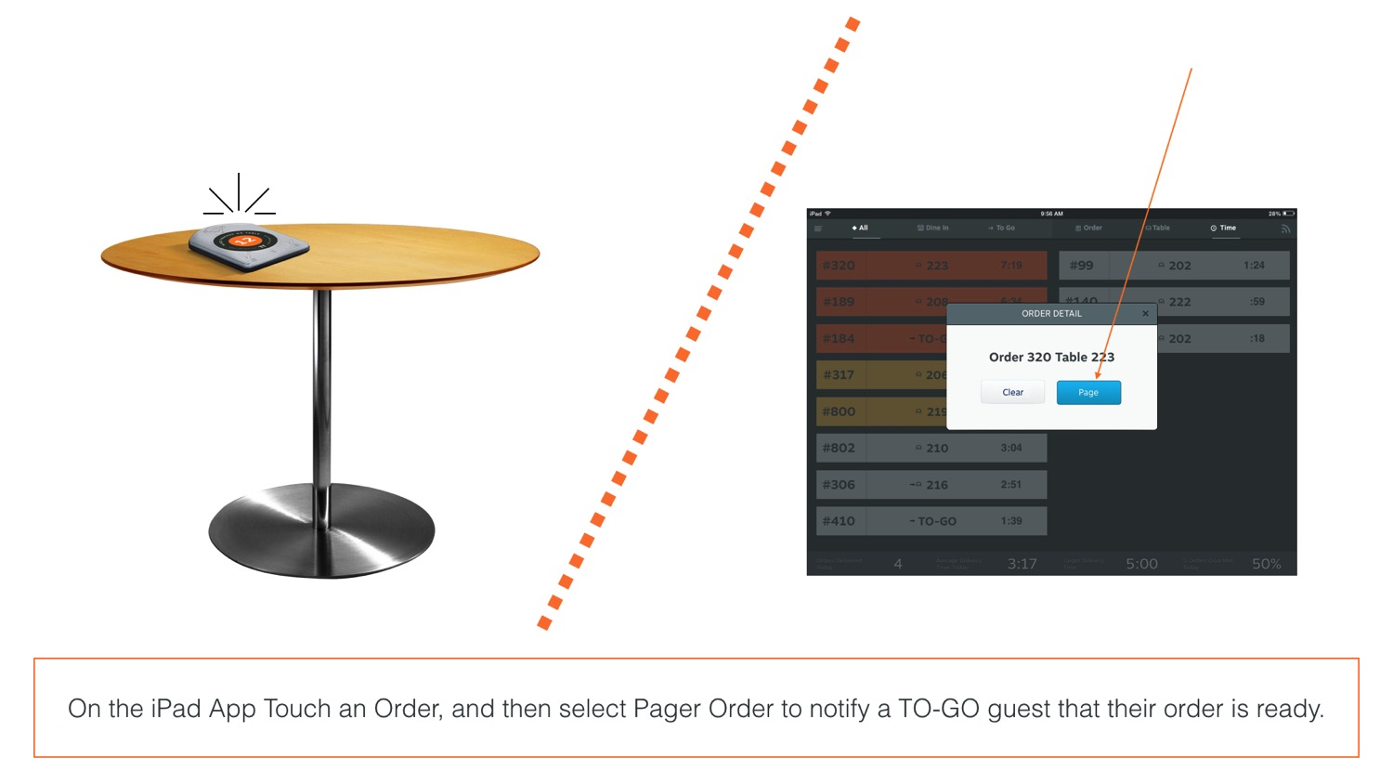
Notes:
TALKING POINTS –
When a to-go order is ready, you have the option to tap on the order strip, and an order detail window will appear.
By touching on the “Page Order” button, you can page the to-go customer to retrieve their order.
QUESTIONS –
How do you locate to-go customers today?
Is that managed in a separate location from your dine-in cashiers?
Is that working for you?

Slide 15
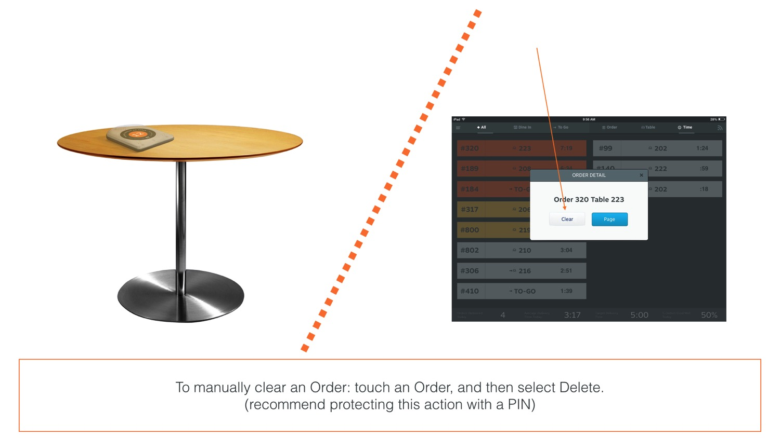
Notes:
TALKING POINTS –
In addition to the red clearing unit we talked about before, there is another option for clearing an order.
On the same order detail window that appears when tapping on an order strip, you can clear an order as well.
This function may be protected by a manager PIN. We’ve had cases where clients have restricted use of clearing orders from the screen to ensure the tracker is first retrieved before it’s cleared from the Table Tracker application screen.
QUESTIONS –
That wraps up the basics of how the system works, do you have any questions?

Slide 16
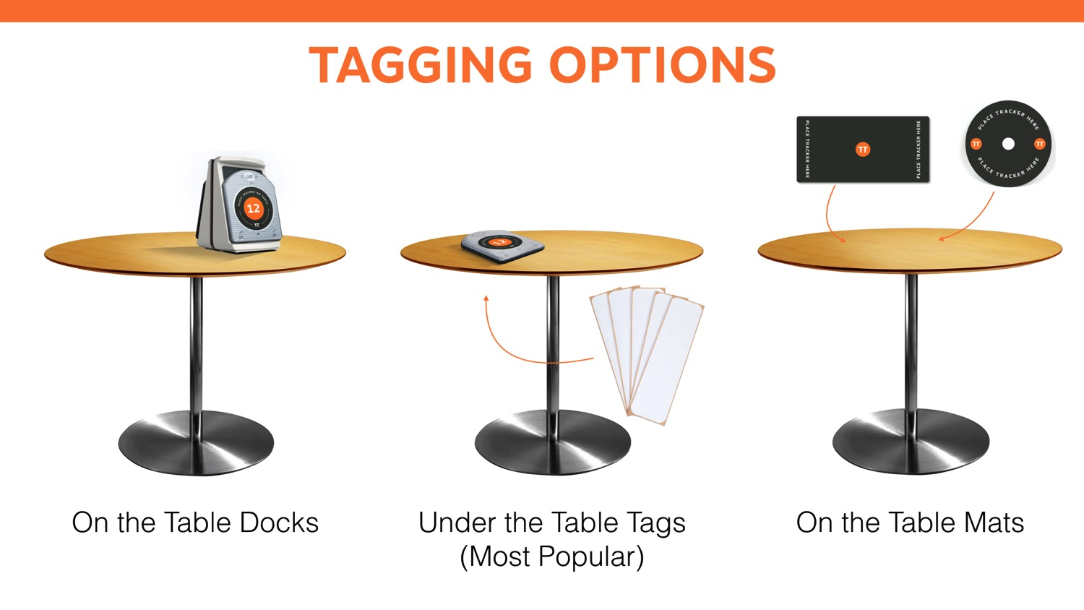
Notes:
TALKING POINTS –
To tag a table, there are two main options – either under the table, or above the table.
By far, the most popular method is tagging the underside of the table where it’s more discreet and unnoticeable by customers.
We also have options for tagging above the table:
Table Mats – flat mats may be placed upon the table with directions letting the customer know to place the tracker upon the mat. There are two size options – a 12-inch circle with or without a hole for table umbrellas, and a 6X12 inch rectangle.
Table Docks – docks are placed on a table, or may even be mounted to a wall. They can be configured standing upright back-to-back as shown here, or lying down length-wise like the starter and clearing units.
Above the table options are most often used outdoors or when tables are made of certain materials (like metal or thick rock).
QUESTIONS –
What material is used for your tables?
Do you have a bar?
Do you have an outdoor patio?

Slide 17
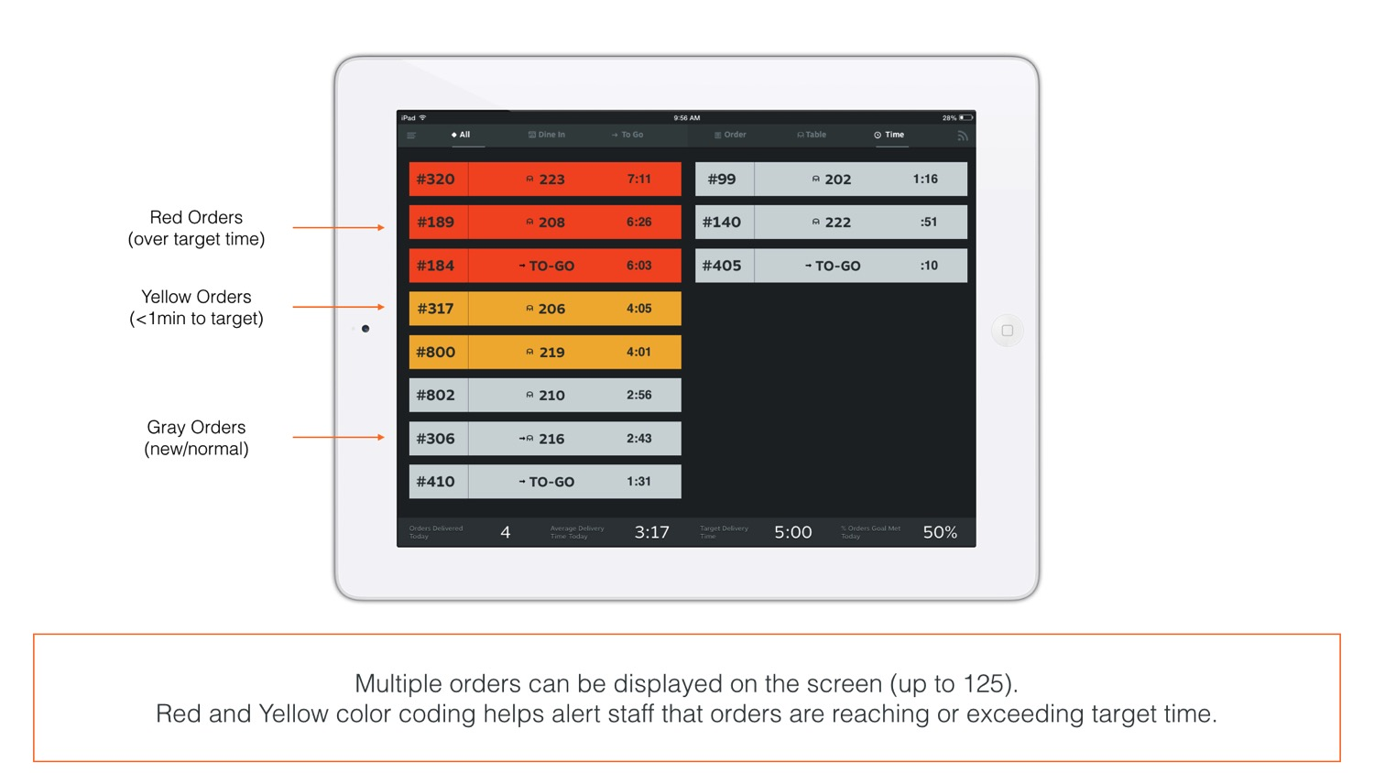
Notes:
TALKING POINTS –
In the order view, up to 16 orders are shown in two-columns. Then, the display shifts to show three columns for up to 24 orders.
Beyond 24 orders, the application paginates so you can swipe to see additional pages of orders. If there are multiple pages, they’re indicated by little dots at the bottom of the order view screen.
In most use cases, there are less than 16 active orders at a time; it’s rare when more than 24 appear.
However, for high-usage situations, the Table Tracker system can manage up to 125 active orders.
Colors are used to alert staff when orders are reaching their goal or have surpassed it. Your delivery target time and warning times are completely configurable. You can set them to your desired times.
QUESTIONS –
How many orders do you manage daily?
What is your maximum number of open/active orders?

Slide 18
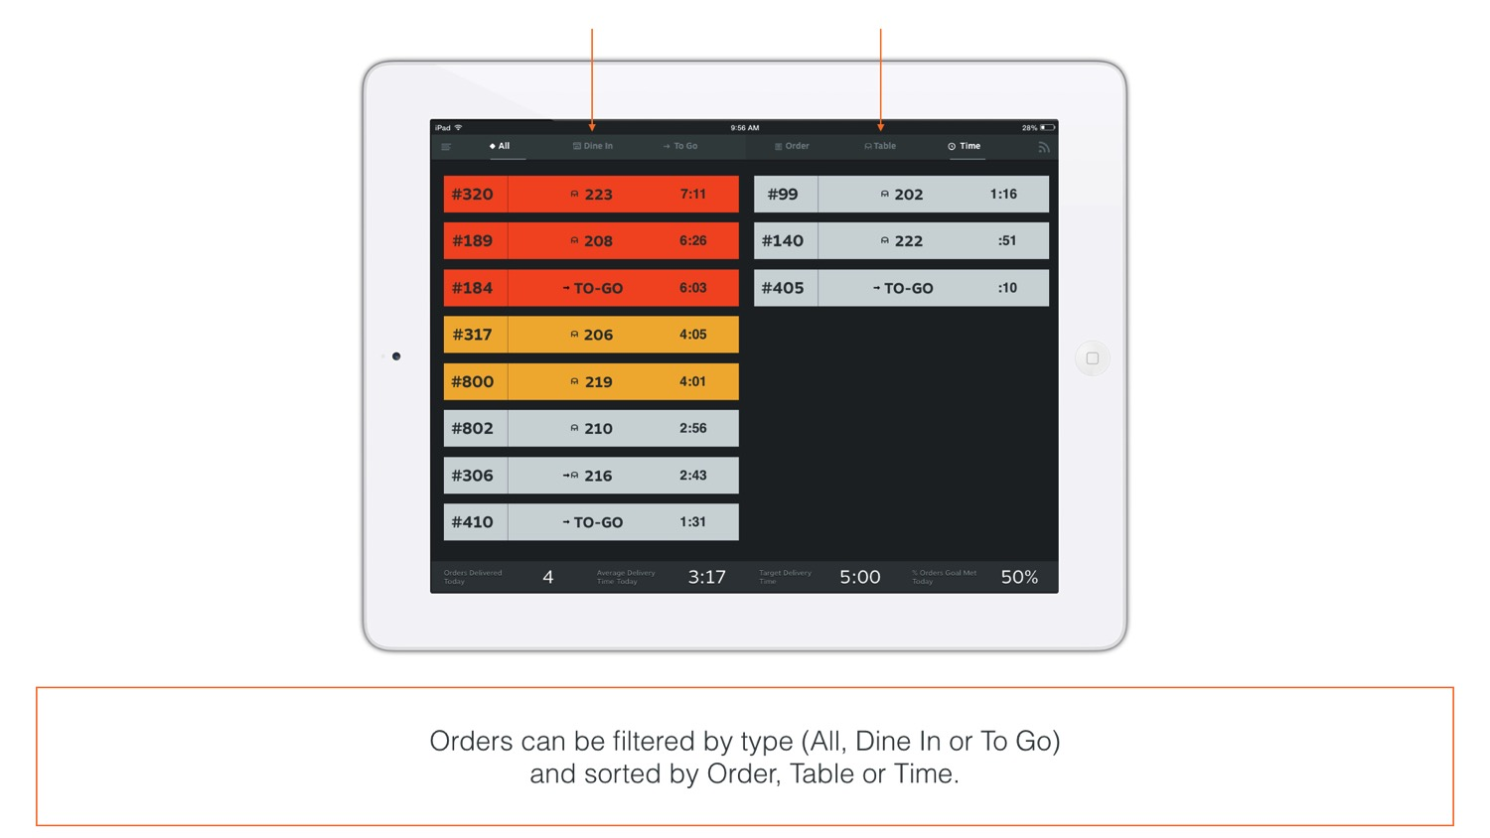
Notes:
TALKING POINTS –
To help locate an order, filters and sorts may be applied to narrow or re-order the selection.
Across the top to the left are filters.
View “all” orders, or narrow the list of orders to only show dine-in or to-go orders.
This is especially useful if you have a separate to-go area. That team can reference their own order view that’s filtered to only to-go customers.
At the same time, you can keep the dine-in food runner’s view filtered to only show dine-in orders.
You can have up to five iPads in one location, all fully functional and working off of the same system.
Across the top right are sorts.
You can re-order the strips by the order number, table number, or time.
The application is defaulted to sort based on time with the most recent order showing up last.
QUESTIONS –
Are there other ways you could imagine wanting to filter or sort your orders?

Slide 19
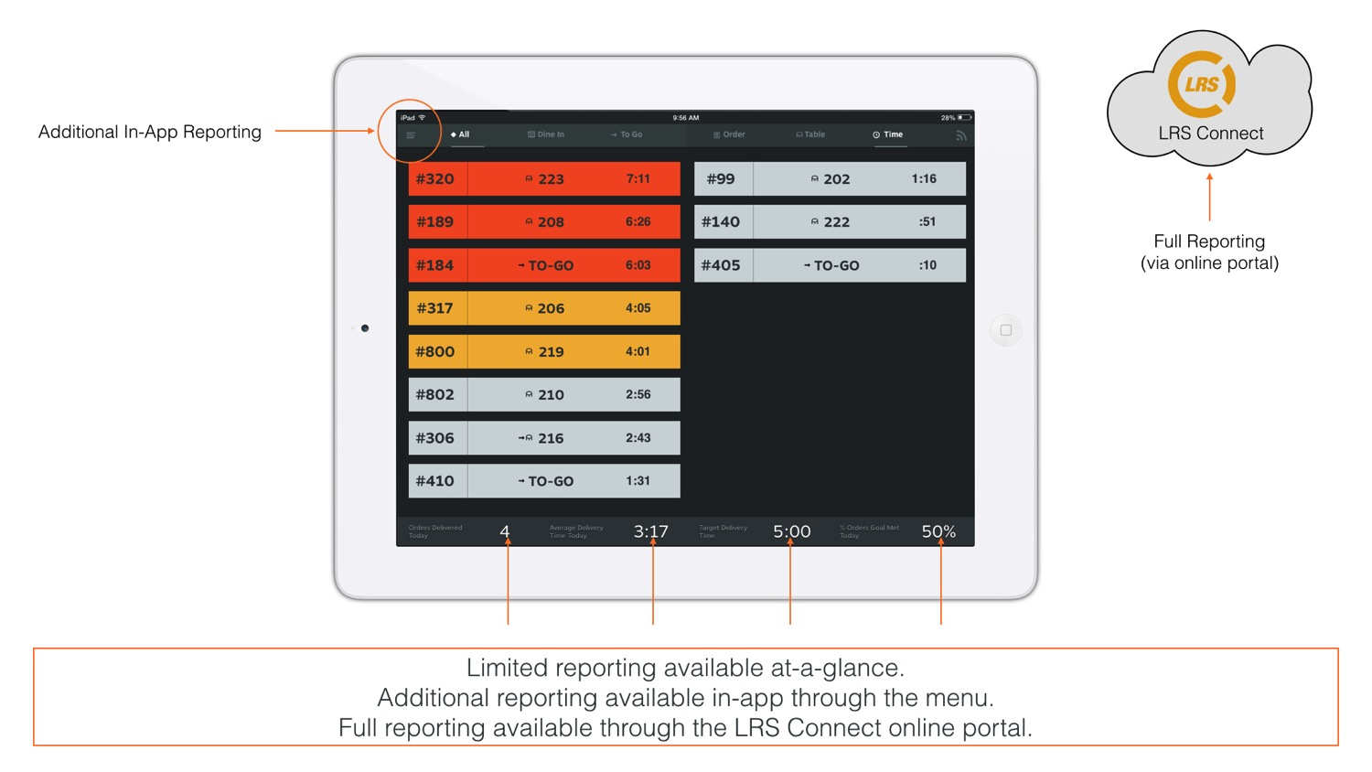
Notes:
TALKING POINTS –
Along the bottom, quick at-a-glance daily stats are provided.
Total orders delivered
Average delivery time
Target delivery time
% of orders that met the delivery goal
Additional reporting is available in the application via the menu.
Provides two-weeks of data.
Displays that store’s performance metrics only – no option to see other stores from the application.
Advanced reporting is available online at LRS Connect – it’s the web portal used to manage your account and access long-term reporting
Provides two-years of data
Seven pre-assembled reports are provided
Compare and contrast performance metrics between stores or groups of stores
Export data files for further analysis or to import into your own reporting tools (an API is available to pull data as well)
QUESTIONS –
Do you have a reporting tool you use to aggregate data from many systems?

Slide 20
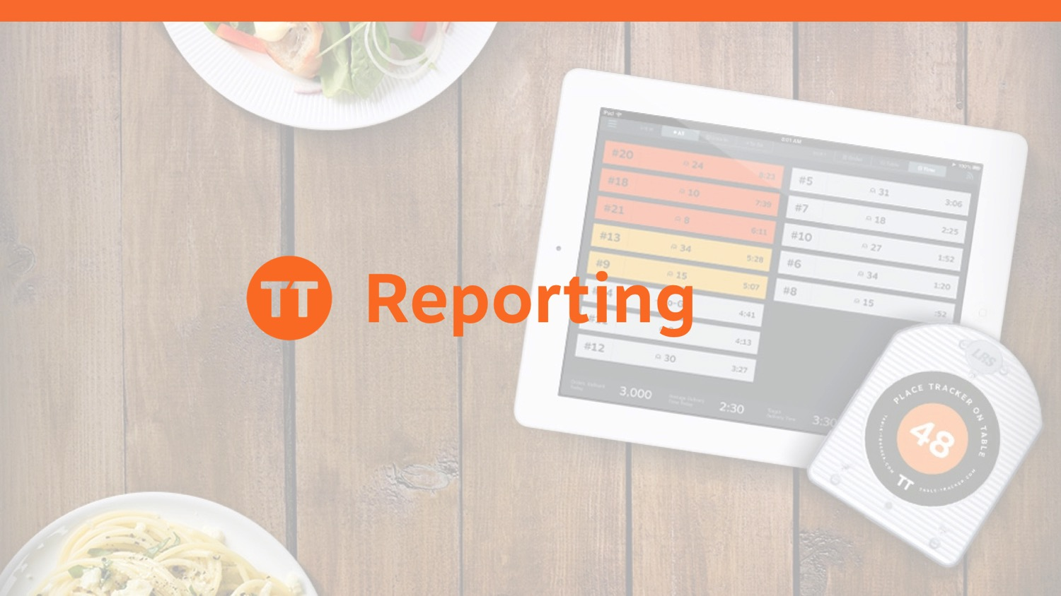

Slide 21
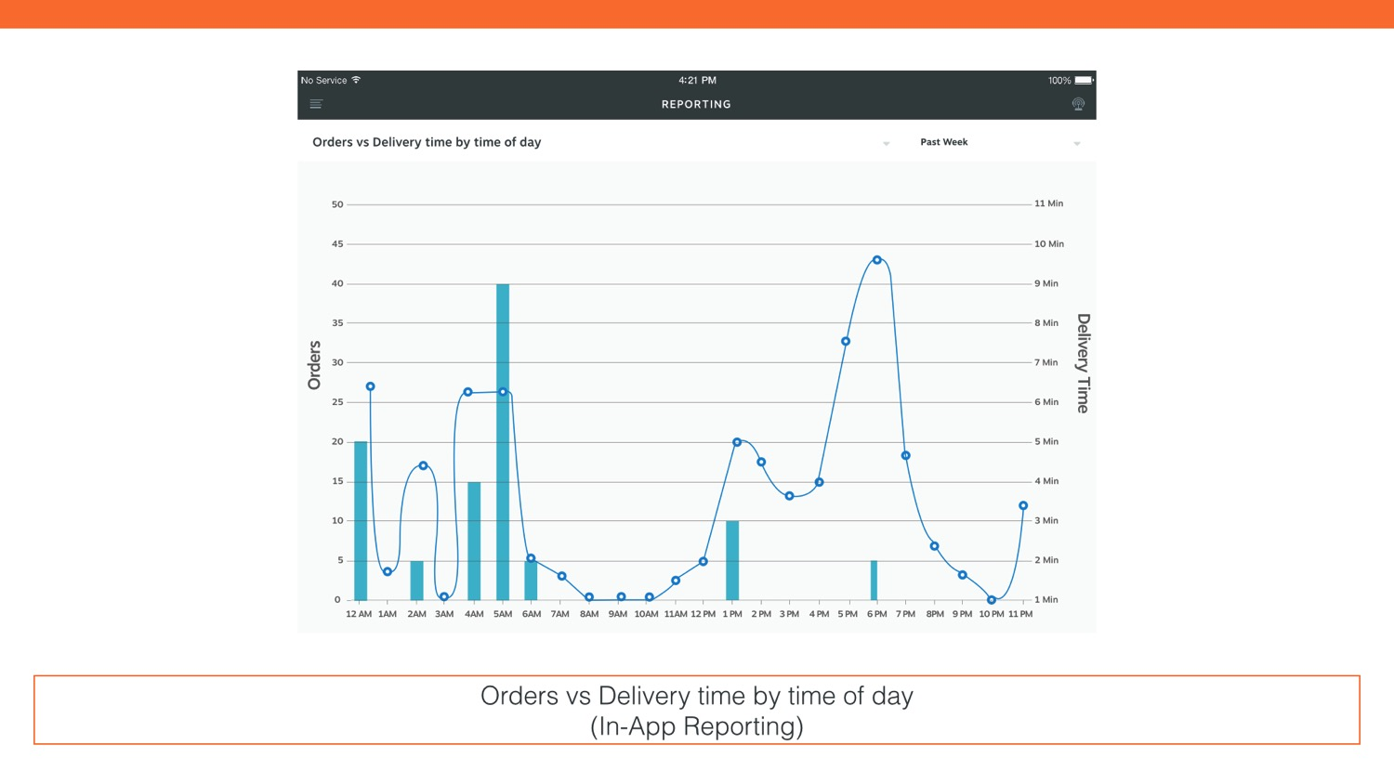

Slide 22
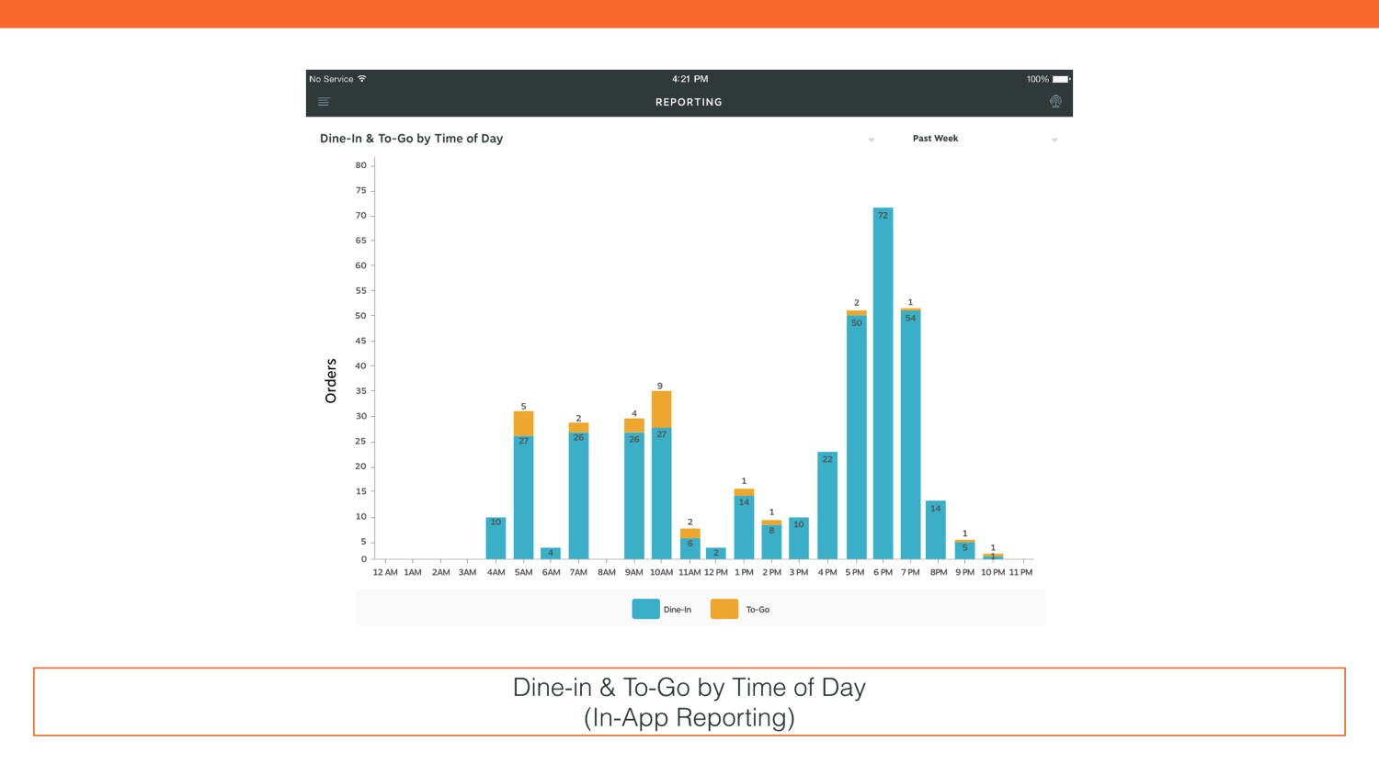

Slide 23
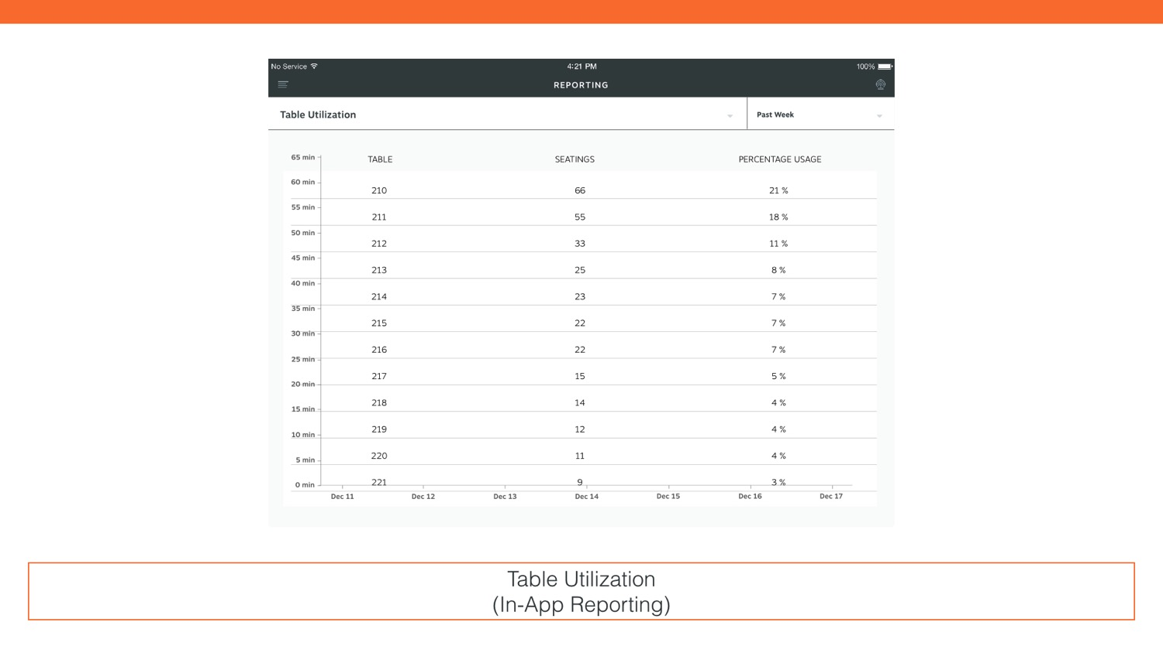

Slide 24
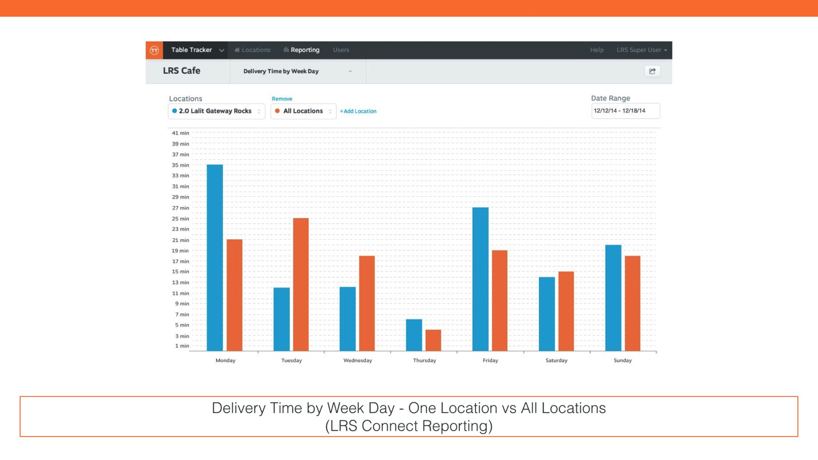

Slide 25
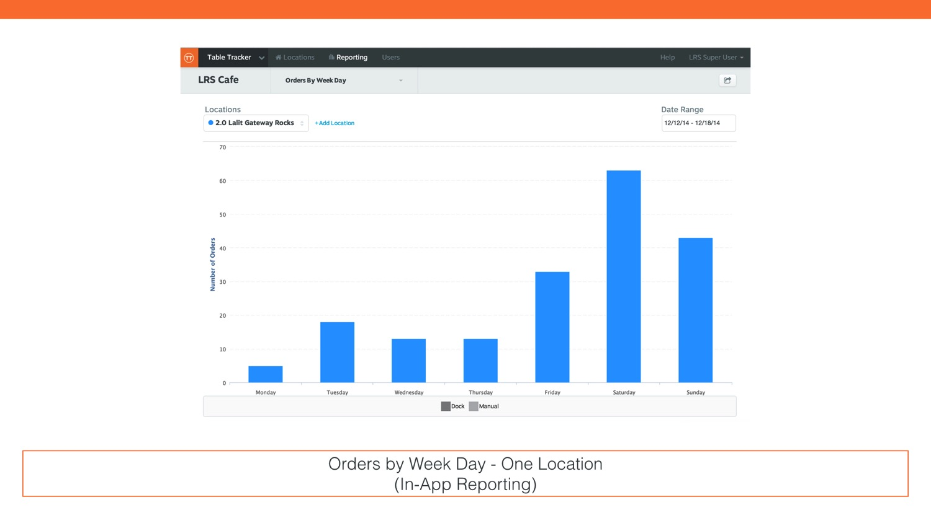

Slide 26
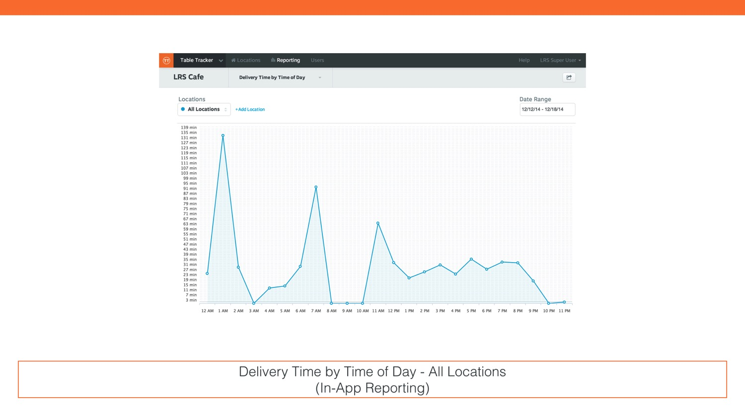

Slide 27
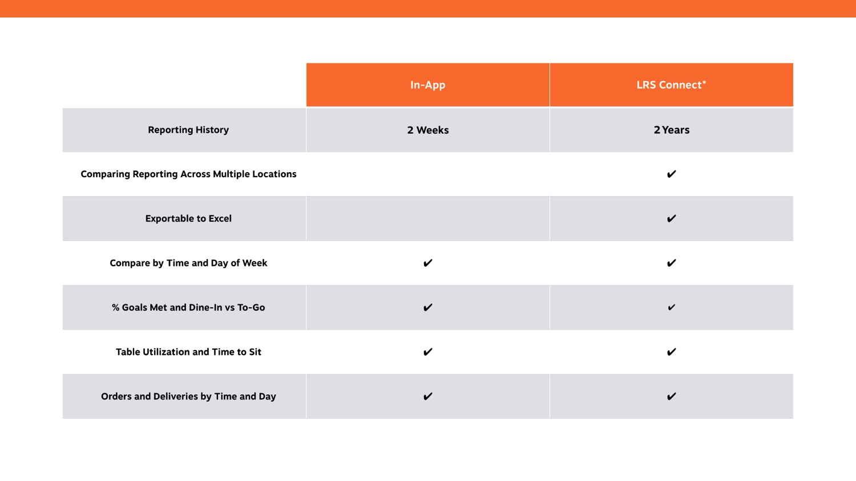

Slide 28
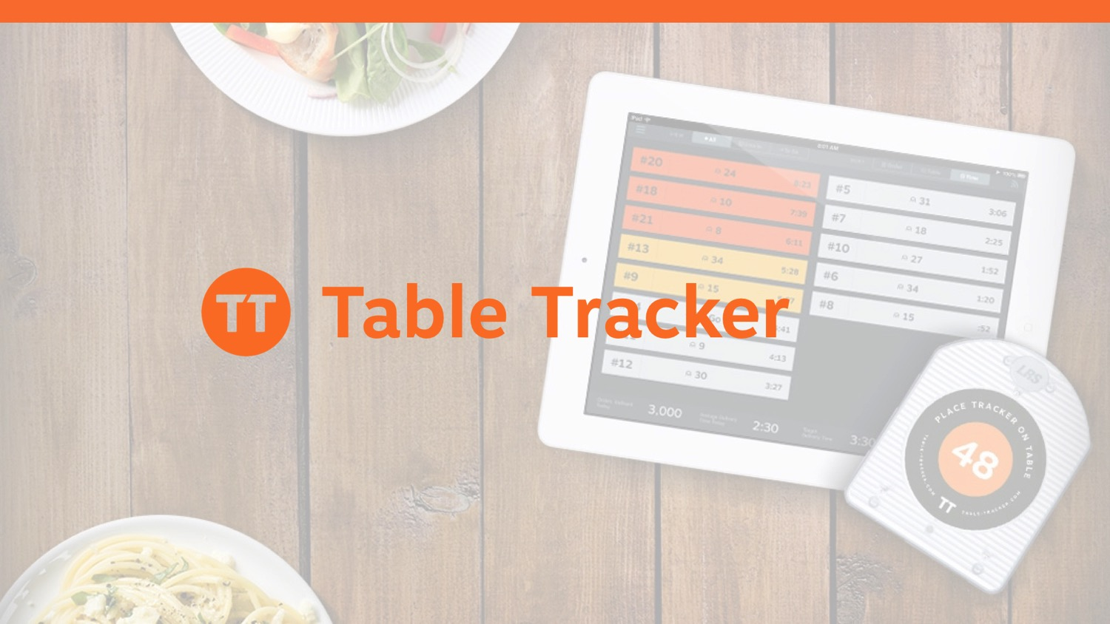

Slide 29
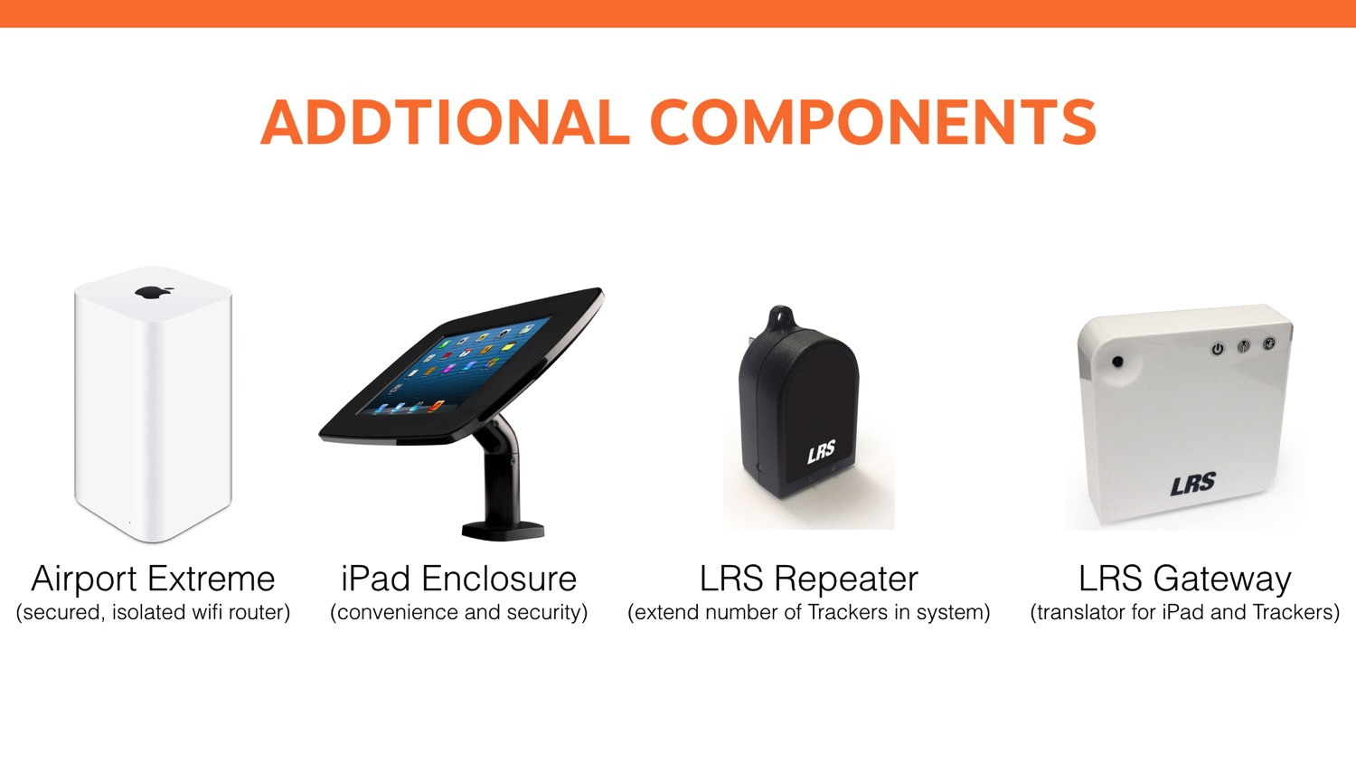
Notes:
TALKING POINTS –
Other system components include:
Airport Extreme – the Airport Extreme provides Wi-Fi for the Table Tracker application and Gateway to communicate with each other.
Airport Extreme is LRS’ recommended router for Table Tracker
Since Table Tracker is a critical operational system, its important that Table Tracker be isolated on it’s own Wi-Fi network to avoid any interference from other Wi-Fi devices or usage.
iPad Enclosure – so you may protect the iPad, LRS can help you source an iPad enclosure with a surface or wall mount option.
LRS Repeater – the Repeaters communicate the location of trackers to the Gateway. One Repeater is needed for every 20 Trackers.
LRS Gateway – The Gateway has two primary uses:
It’s the brain of the operations, storing the state and location of each tracker and communicating that to the iPad to display in the app.
And when connected to the Internet, the Gateway synchs with LRS Connect to upload data; LRS Connect is the portal that provides advanced reporting and stores data for up to two years.
QUESTIONS –
Do you have any questions?

Slide 30
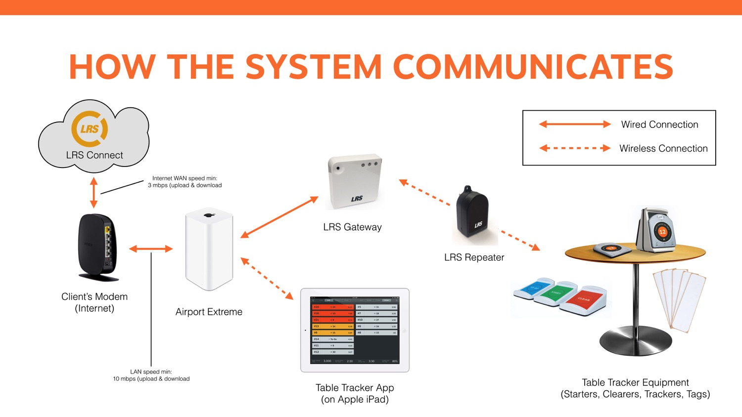
Notes:
TALKING POINTS –
An active Wi-Fi network is required to use Table Tracker.
The Wi-Fi network allows your Gateway to communicate with your iPad.
It’s recommended that an Apple Airport Extreme be used to establish a Wi-Fi network for use by the Table Tracker system alone.
The router (Airport Extreme) is connected to the Internet so that system data may be shared with LRS Connect for extended reporting online.
QUESTION –
Do you have Internet available at your location(s)?
Do you have an IT department?

Slide 31
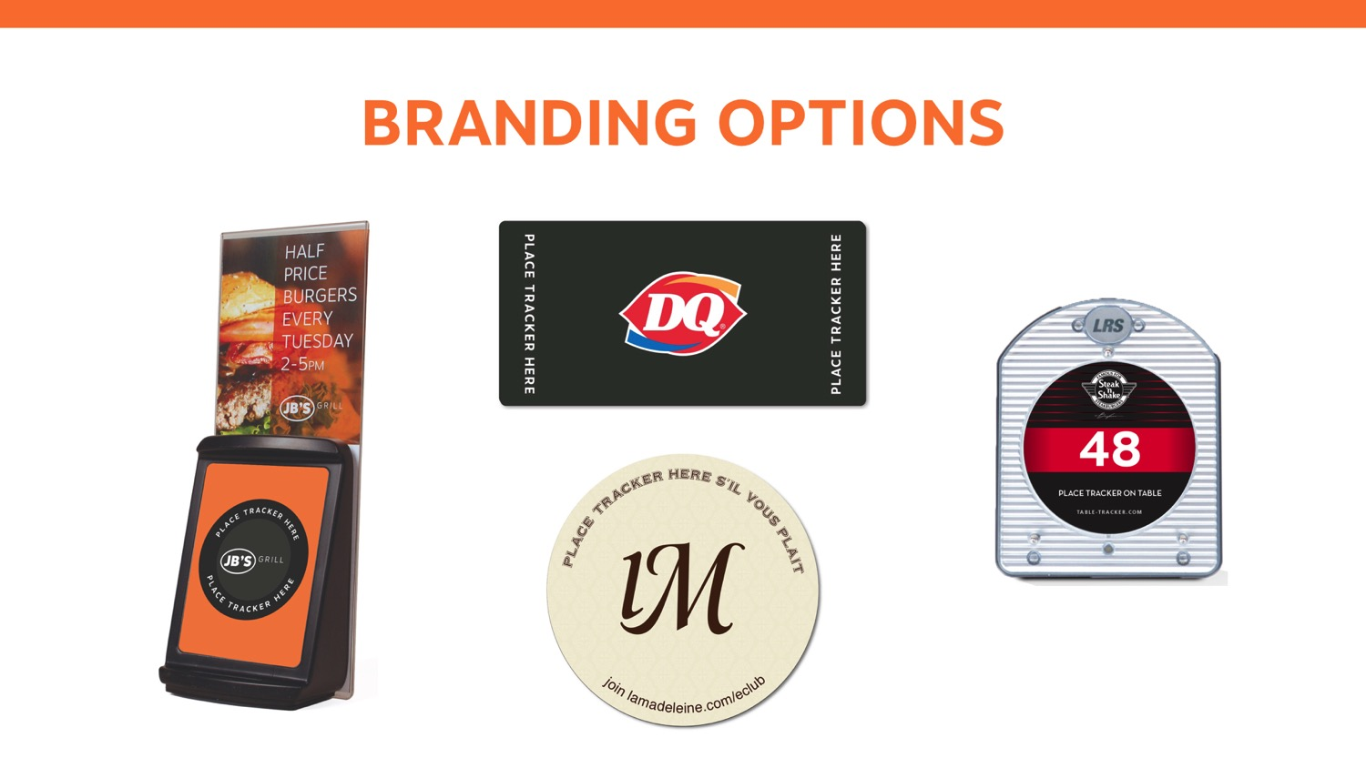
Notes:
TALKING POINTS –
Certain components may be branded with your restaurant logo, colors, and images.
Provides you an opportunity to customize the elements to better fit within your atmosphere.
Design and printing costs apply.

